Slide 1




Lesson 11: Text Clustering and Classification
Introduction to machine learning for text
Haihua Chen, Ph.D.
Assistant Professor
94022000057
Haihua.chen@unt.edu

Slide 2

Agenda
1
Machine Learning
2
Text Clustering
3
Text Classification
4
Python Examples

Slide 3
1
What is Machine Learning?

Slide 4


1.1. Why is Machine learning?
Machine learning consists of applying mathematical and statistical approaches to get machines to learn from data. It consists of four big families of techniques:
Supervised learning
Semi-supervised learning
Unsupervised learning
Reinforcement learning

Slide 5
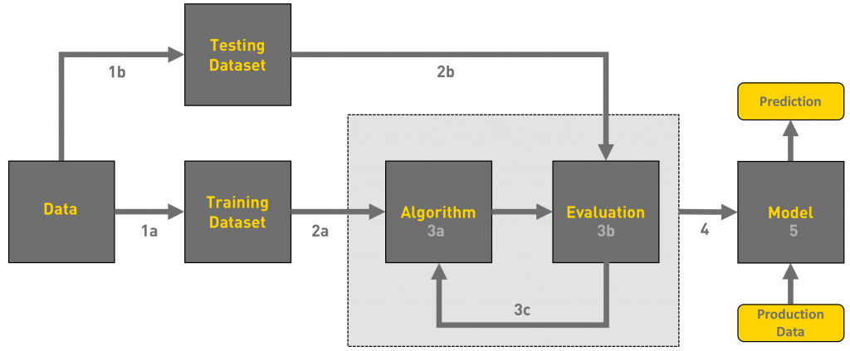
1.2. Supervised learning

Slide 6
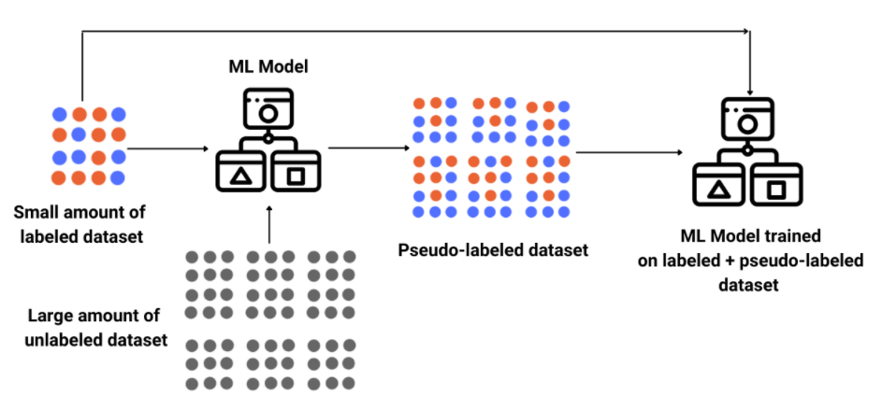
1.3. Semi-supervised learning

Slide 7
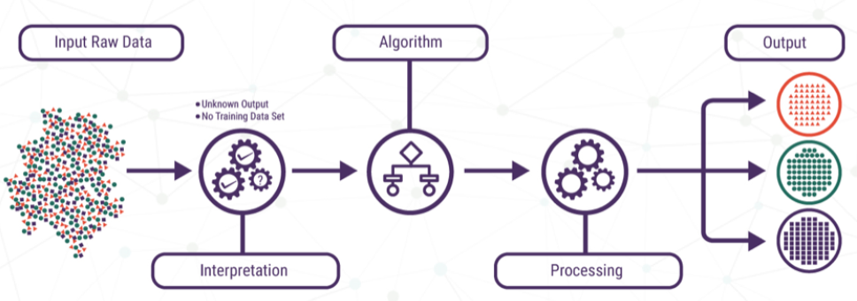
1.4. Unsupervised learning

Slide 8
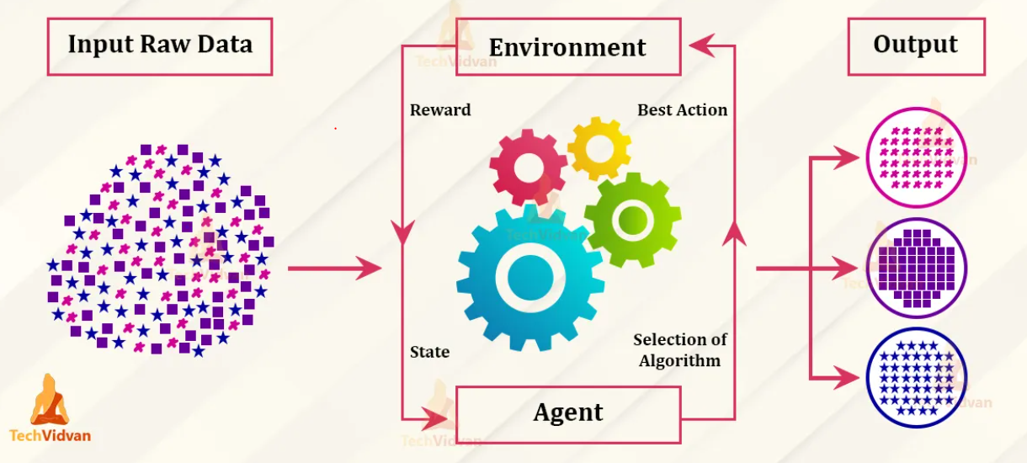
1.5. Reinforcement learning
Notes:
In reinforcement learning, the system learns exclusively from a series of reinforcements. Those can be positive or negative in relation to a system goal. Positive ones are known as “rewards” while on the other hand, we’ll call the negative ones “punishments”.
For instance, let’s take a model playing a video game. The system gets a reward when it wins more points. But then, if it loses, the model will receive a punishment. As a result, the model can then identify what moves were good in terms of strategy.
The moves’ values will then be added to each other to build a short-term strategy as well as a long-term one. As a consequence, the model will learn how to play the game and accumulate the most awards possible.
Finally, the model evolves with each action and reward or per batch of actions and rewards.

Slide 9
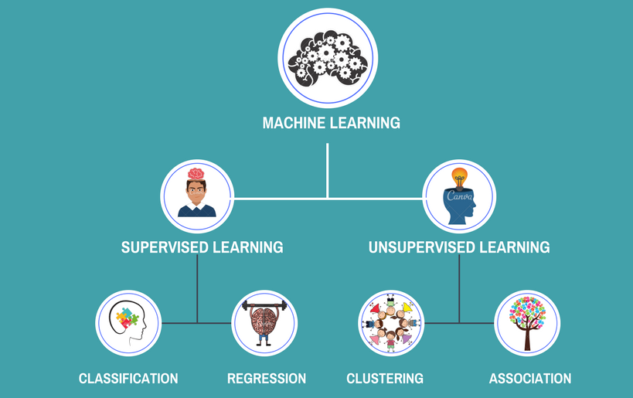
1.6. How is text clustering different from text classification?
Notes:
Classification is a supervised learning approach that maps an input to an output based on example input-output pairs. Clustering is an unsupervised learning approach.
Classification: If the prediction value tends to be category like yes/no or positive/negative, then it falls under classification type problem in machine learning. The different classes are known in advance. For example, given a sentence, predict whether it's a negative or positive review.
Clustering: Clustering is the task of partitioning the dataset into groups called clusters. The goal is to split up the data in such a way that points within single cluster are very similar and points in different clusters are different. It determines grouping among unlabeled data.

Slide 10
2
Text Clustering

Slide 11
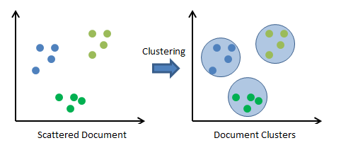
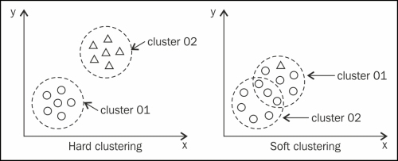
2.1. What is text clustering?
Text clustering is the task of grouping a set of unlabeled texts in such a way that texts in the same cluster are more similar to each other than to those in other clusters. Text clustering algorithms process text and determine if natural clusters (groups) exist in the data:
Text clustering
Types of clustering
Notes:
The amount of text data being generated in the recent years has exploded exponentially. It's essential for organizations to have a structure in place to mine actionable insights from the text being generated. From social media analytics to risk management and cybercrime protection, dealing with textual data has never been more important.
Broadly, clustering can be divided into two groups:
Hard Clustering: This groups items such that each item is assigned to only one cluster. For example, we want to know if a tweet is expressing a positive or negative sentiment. k-means is a hard clustering algorithm.
Soft Clustering: Sometimes we don't need a binary answer. Soft clustering is about grouping items such that an item can belong to multiple clusters. Fuzzy C Means (FCM) is a soft clustering algorithm.

Slide 12
2.2. Text clustering applications?
Document Retrieval: To improve recall, start by adding other documents from the same cluster.
Taxonomy Generation: Automatically generate hierarchical taxonomies for browsing content.
Fake News Identification: Detect if a news is genuine or fake.
Language Translation: Translation of a sentence from one language to another.
Spam Mail Filtering: Detect unsolicited and unwanted email/messages.
Customer Support Issue Analysis: Identify commonly reported support issues.
Others?
Notes:
It’s useful in various image recognition platforms and also various image segregation tasks. One such example is the biological field.
Here, this can help the researchers to categorize and classify certain unknown species.
Clustering can come in handy for the city’s crime branch for classifying different parts of a city based on the crime-rate.
The algorithm can classify and tell based on the frequency and number of cases that, which part has more criminal activities.
It’s quite useful in data-mining as well because clustering can help in understanding the data.
It can be useful for banks as a fraud detection algorithm. The bank sector faces a problem of credit card scams and frauds.
Using clustering we can uncover several hidden patterns that may tell us which scheme is a fraudulent scheme.
We can understand various seismic zones based on the data and the clustering algorithm can create clusters of various seismic activities and active regions.
In the health industry as well, we can use this algorithm to detect various ailments, especially tumors and cancers.
The search engine is a prime example of the clustering technique.
It categorizes search results on the basis of billions of searches and has the results ready at the go every time for every search.
It can be of great use in analyzing data of soil for agriculture.
With the data of the soil it can classify whether the soil has the necessary nutrient content for growing crops.
It is also useful in the case of advertising the product based on customer interest and feedback.

Slide 13
2.3. Levels of text clustering?
Document level: It serves to regroup documents about the same topic. Document clustering has applications in news articles, emails, search engines, etc.
Sentence level: It's used to cluster sentences derived from different documents. Tweet analysis is an example.
Word level: Word clusters are groups of words based on a common theme. The easiest way to build a cluster is by collecting synonyms for a particular word. For example, WordNet is a lexical database for the English language that groups English words into sets of synonyms called synsets.

Slide 14
2.4. Steps of text clustering?
Text pre-processing: Text can be noisy, hiding information between stop words, inflexions and sparse representations. Pre-processing makes the dataset easier to work with (Tokenization, Transformation, Normalization, Filtering).
Feature Extraction: One of the commonly used technique to extract the features from textual data is calculating the frequency of words/tokens in the document/corpus (Lexical features, Semantic features, Word embedding features).
Clustering: We can then cluster different text documents based on the features we have generated.

Slide 15
2.5. Measuring similarity in text clustering?
Lexical similarity: Words are similar lexically if they have a similar character sequence. Lexical similarity can be measured using string-based algorithms that operate on string sequences and character composition.
Semantic similarity: Words are similar semantically if they have the same meaning, are opposite of each other, used in the same way, used in the same context or one is a type of another. Semantic similarity can be measured using corpus-based or knowledge-based algorithms.
Some of the metrics for computing similarity between two pieces of text are Jaccard coefficient, cosine similarity and Euclidean distance.

Slide 16
2.6. Text clustering algorithms?
Centroid-based clustering: we form clusters around several points that act as the centroids
Density-based clustering: the clustering doesn’t happen around centroid or central points, but the cluster forms where the density looks higher
Distribution-based clustering: if the distance between the point and the central distribution of points increases, then the probability of the point being included in the distribution decreases.
Hierarchical clustering: we deal with either merging of clusters or division of a big cluster

Slide 17
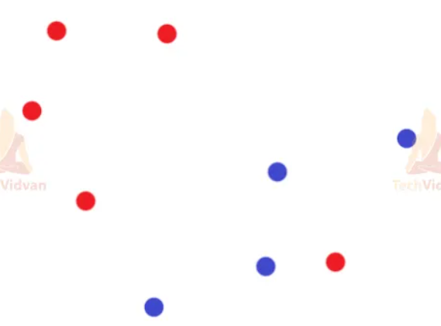
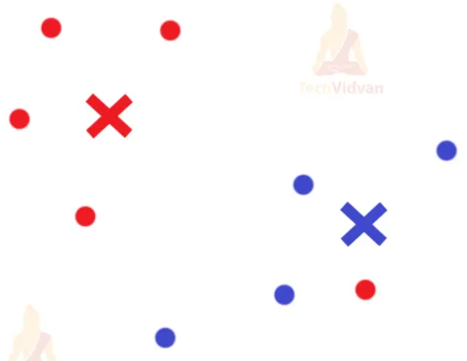
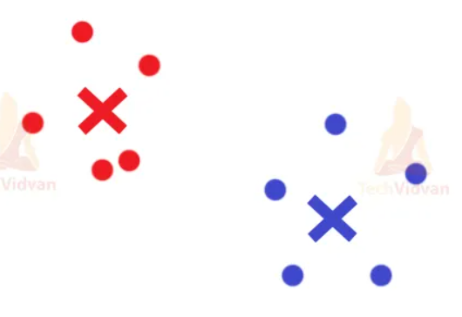
2.6.1 Centroid-based clustering
K-means Clustering: The algorithm measures the Euclidean distances between the datapoints and all k centroids

Slide 18
2.6.2 Density-based clustering
DBSCAN uses a fixed distance for separating the dense clusters from the noise datapoints. It is the fastest among clustering algorithms.
from sklearn.cluster import DBSCAN
model = DBSCAN(eps=0.20, min_samples=5)
eps is the max. distance between two data points.
min_samples helps to set the minimum number of samples we want within a neighborhood collection of features.
HDBSCAN uses a range of distances to separate itself from the noise. It requires the least amount of user-input.
OPTICS measures the distance between neighboring features, and it draws a reachability plot to separate itself from the noise datapoints.
Notes:
https://www.kdnuggets.com/2020/04/dbscan-clustering-algorithm-machine-learning.html

Slide 19
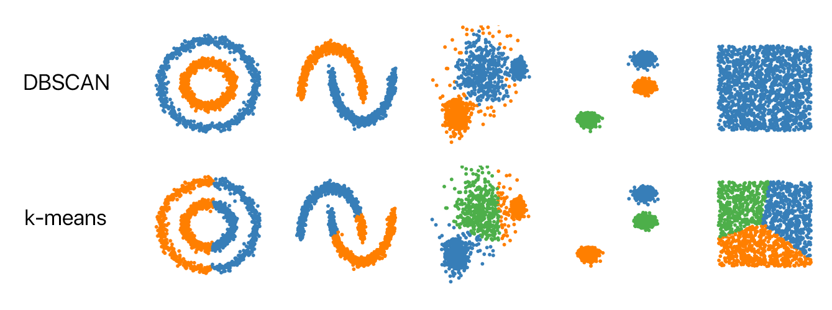
2.6.2 Density-based clustering-DBSCAN
Notes:
https://www.kdnuggets.com/2020/04/dbscan-clustering-algorithm-machine-learning.html

Slide 20
2.6.2 Density-based clustering-DBSCAN
Algorithmic steps for DBSCAN clustering
The algorithm proceeds by arbitrarily picking up a point in the dataset (until all points have been visited).
If there are at least ‘minPoint’ points within a radius of ‘ε’ to the point then we consider all these points to be part of the same cluster.
The clusters are then expanded by recursively repeating the neighborhood calculation for each neighboring point
Notes:
https://www.digitalvidya.com/blog/the-top-5-clustering-algorithms-data-scientists-should-know/

Slide 21
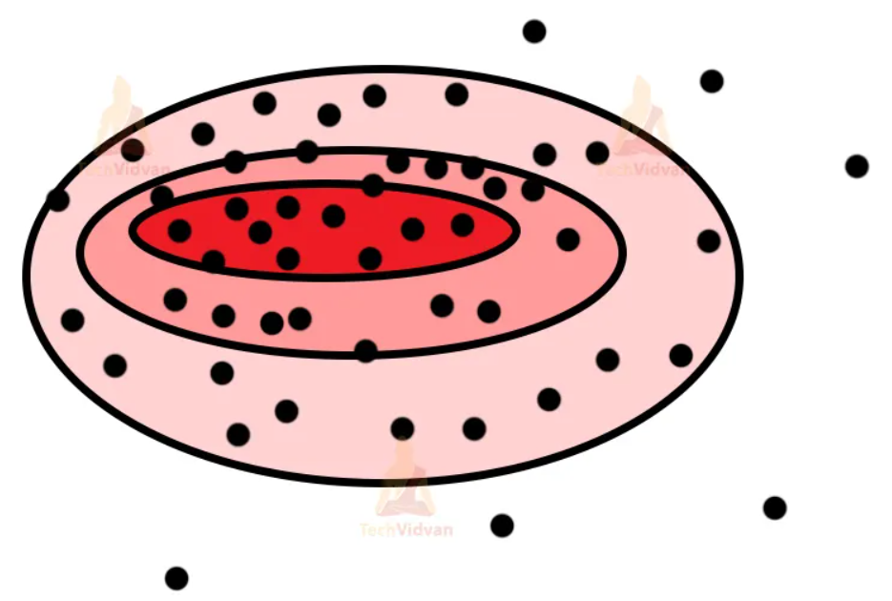
2.6.3 Distribution-based clustering
Gaussian distribution model: there will be a fixed number of distributors for the Gaussian model. These distributors are concentric figures with decreasing color intensity from inside to the outside. The central part tends to be denser, and it tends to decrease as we go outside as we have bigger distributors now. So, even though distributors might contain the same number of points, their densities may still differ due to the size of distributors. Overfitting can be a bit of a problem for this type of clustering. As long as we don’t set any strong criteria for points, we can avoid overfitting.

Slide 22
2.6.4 Hierarchical clustering
Agglomerative hierarchical clustering: merge smaller clusters into bigger clusters. But this also has some process. If the two clusters that we compare have similarities between them and if they are near to each other, then we merge them.
Divisive hierarchical clustering: divide one big cluster into n-smaller clusters. The clusters here are divided if some datapoints are not similar to the larger cluster; we separate them and make an individual cluster for them.
In hierarchical clustering, the most important job is to calculate the similarity between clusters. It’s the most important part as it helps us to understand whether to merge or divide the cluster. We have several methods like:
Single Linkage Algorithm (MIN)
Complete Linkage Algorithm (MAX)
Group Average
Distance Between the Centroids
Ward’s Method
Notes:
It’s the most important part as it helps us to understand whether to merge or divide the cluster. We have several methods like:
Single Linkage Algorithm (MIN)
In this, we take two points from two individual clusters and these points have to be the closest to each.
We then calculate the distance and similarity between them.
It works well for separating non-elliptical clusters.
Noise in the data can create problems.
Complete Linkage Algorithm (MAX)
This is the exact opposite of the MIN algorithm.
We take the distance between the two farthest points in two clusters and measure the distance and similarities.
It works well even in the presence of noise.
However, it can accidentally break bigger clusters as well.
Group Average
Here, we take all the points and then measure them.
It can accurately separate clusters even if there remains noise in between clusters.
Distance Between the Centroids
We can measure the distance between the centroids of both the clusters.
Although it’s not used that much as you have to find the centroid after every merge or divide.
Ward’s Method
This one is the last method to calculate the similarity.
Here, instead of taking the average, we take the sum of squares of distances.
Note:- The complexity of space in hierarchical clustering is O(n2). We require lots and lots of space to hold the matrix. For time complexity it is O(n3). The iterations we perform can get complex if there is a large dataset.

Slide 23
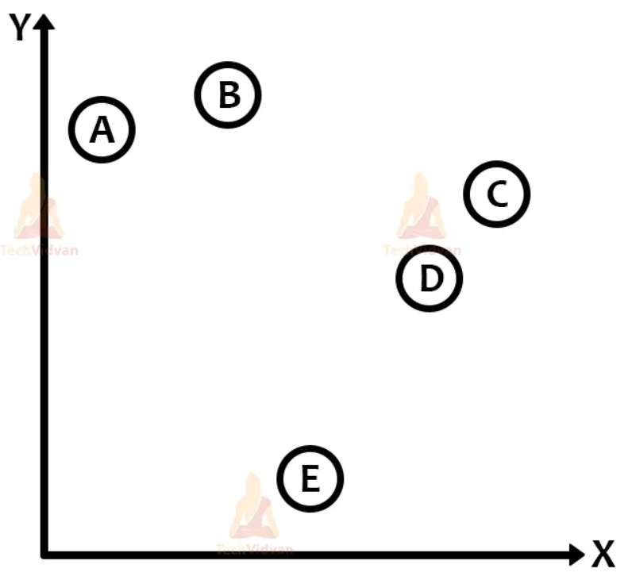
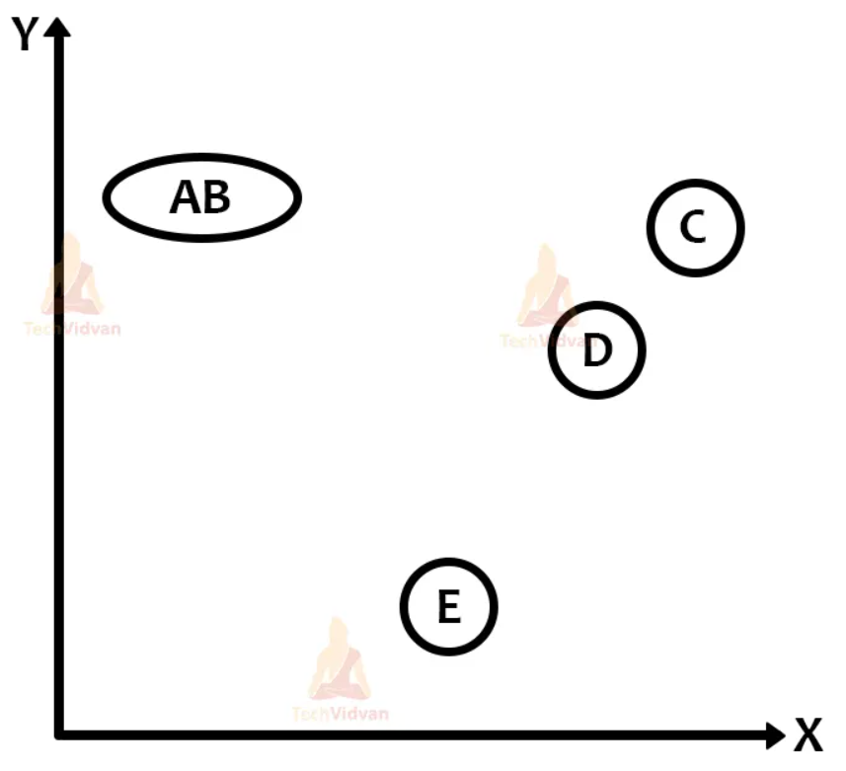
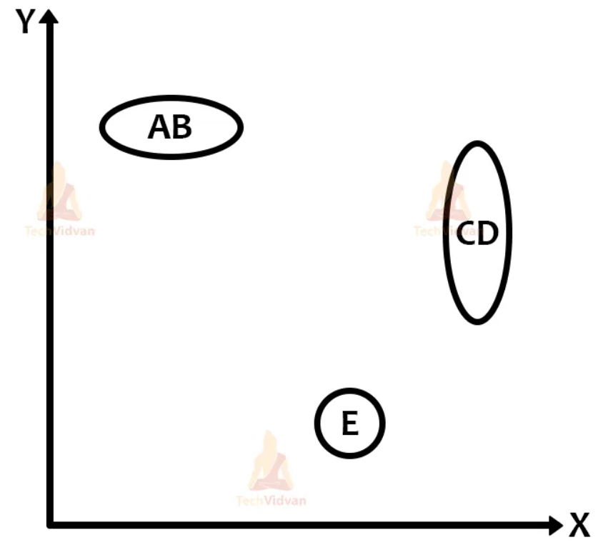
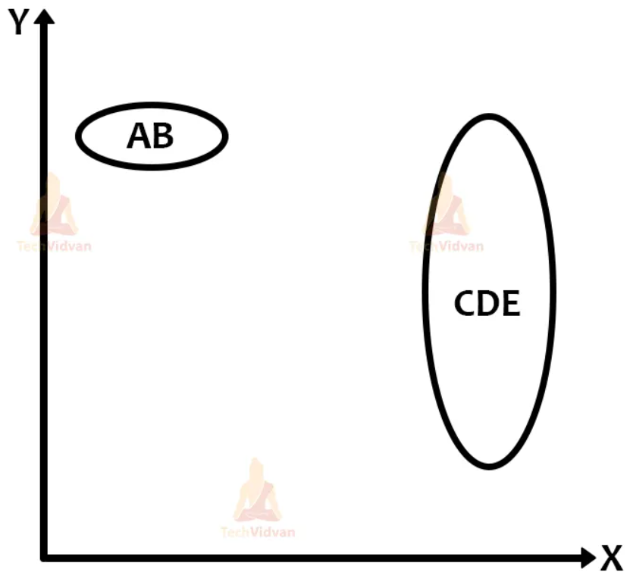
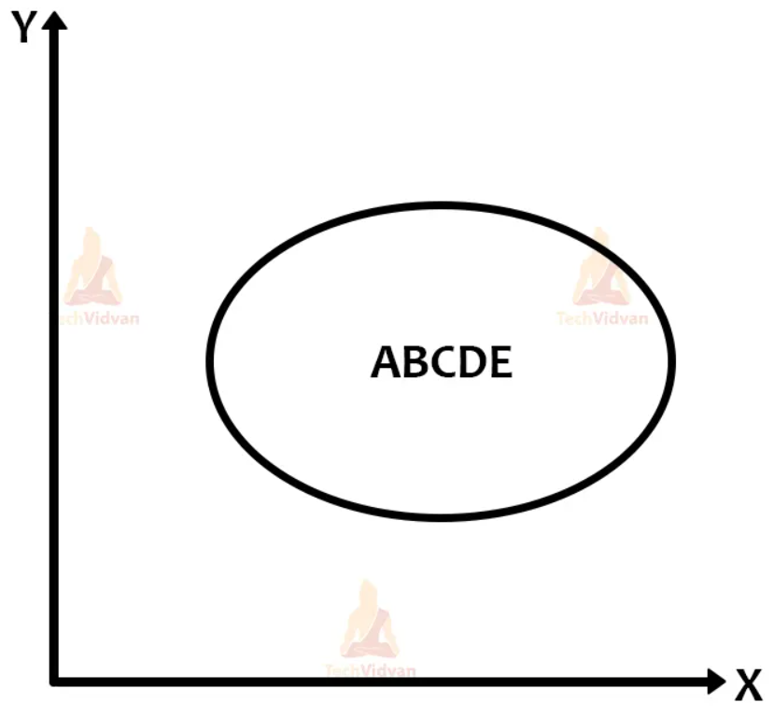
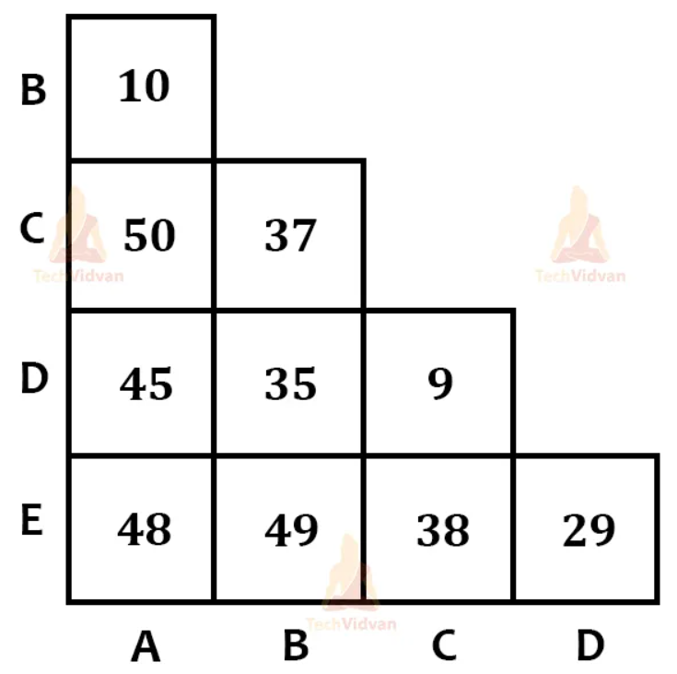
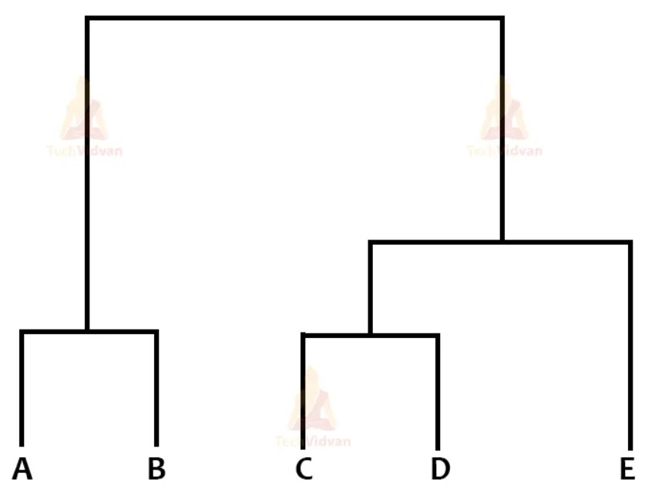
2.6.4 Hierarchical clustering

Slide 24
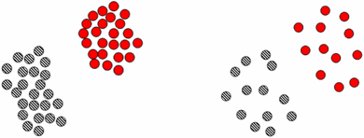
2.7. Text clustering evaluation?
External quality measure: External knowledge is required for measuring the external quality. For example, we can conduct surveys of users of the application that includes text clustering.
Internal quality measure: The evaluation of the clustering is compared only with the result itself, that is, the structure of found clusters and their relations to one another. Two main concepts are compactness and separation. Compactness measures how closely data points are grouped in a cluster. Separation measures how different the found clusters are from each other. More formally, compactness is intra-cluster variance whereas separation is inter-cluster distance.

Slide 25
2.8. Text clustering challenges?
Document clustering is being studied for many decades. It's far from trivial or a solved problem. The challenges include the following:
Selecting appropriate features of documents that should be used for clustering.
Selecting an appropriate similarity measure between documents.
Selecting an appropriate clustering method utilizing the above similarity measure.
Implementing the clustering algorithm in an efficient way that makes it feasible in terms of memory and CPU resources.
Finding ways of assessing the quality of the performed clustering.
Notes:
Source: https://devopedia.org/text-clustering#qst-ans-9

Slide 26
3
Text Classification

Slide 27
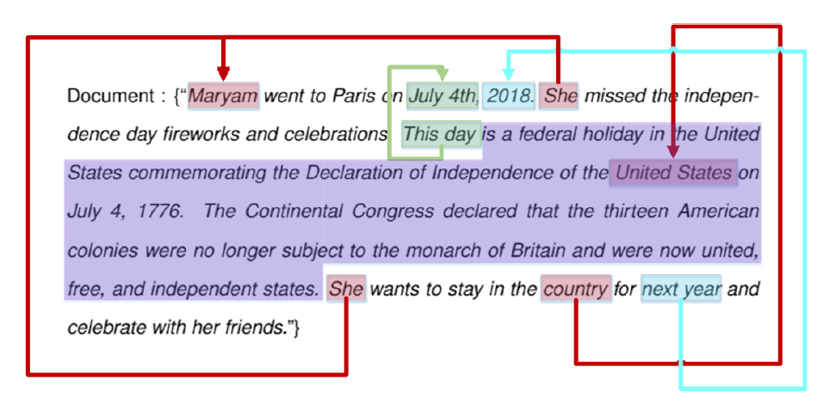
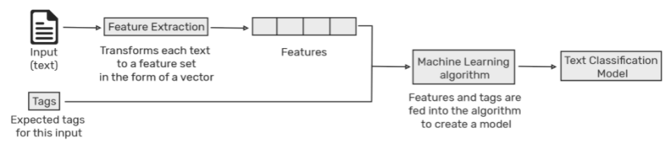
3.1. What is text classification?
Text classification is a simple, powerful analysis technique to sort the text repository under various tags, each representing specific meaning. Typical classification examples include categorizing customer feedback as positive or negative, or news as sports or politics.
Text classification example
Text classification process
Notes:
Abundant textual data accumulates in any eco-system, unstructured and in diverse formats. To extract trends or meaningful insights from it, we need to sort data into different categories.

Slide 28
3.2. Text classification applications?
Information Retrieval: With the rapid growth of online information, particularly in text format, text classification has become a significant technique for managing this type of data
Information Filtering: Information filtering refers to the selection of relevant information or rejection of irrelevant information from a stream of incoming data.
Sentiment Analysis: Sentiment classification methods classify a document associated with an opinion to be positive or negative.
Recommender Systems: Content-based recommender systems suggest items to users based on the description of an item and a profile of the user’s interests
Knowledge Management: text classification has been used to find the relationship between railroad accidents’ causes and their correspondent descriptions in reports
Document Summarization: Text classification used for document summarizing in which the summary of a document may employ words or phrases which do not appear in the original document
Others: Health, Social Sciences, Business and Marketing, Law

Slide 29
3.3. Levels of text classification?
Document level
Paragraph level
Sentence level
Sub-sentence level

Slide 30
3.4. Steps of text classification?
Tokenization: Identifying words, symbols, emojis, hyperlinks, based on known delimiters and format rules.
Word normalization: Reduce derived words into their root form (developmental becomes develop, encouragement becomes encourage).
Text and feature encoding: ML models require numeric features and labels to provide a prediction.
Feature representation: Every feature (category) is represented as a Word Count Vector (giving frequency count of each feature) or a TF-IDF vector (Term Frequency/Inverse Document Frequency) representing relative importance of a term in a document.
Word/Document embedding: Every row in the dataset is an entire document, represented as a dense vector. The word position within the vector is learned from text and based on the surrounding words. Word embeddings can be trained using the input corpus but pre-trained embeddings (Glove, FastText, and Word2Vec) are available.

Slide 31
3.5. Text classification algorithms?
Naive Bayes Classifier
K-nearest Neighbor
Support Vector Machine (SVM)
Decision Tree
Random Forest
Deep Learning

Slide 32
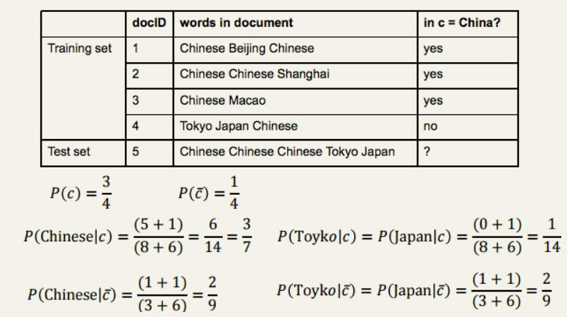
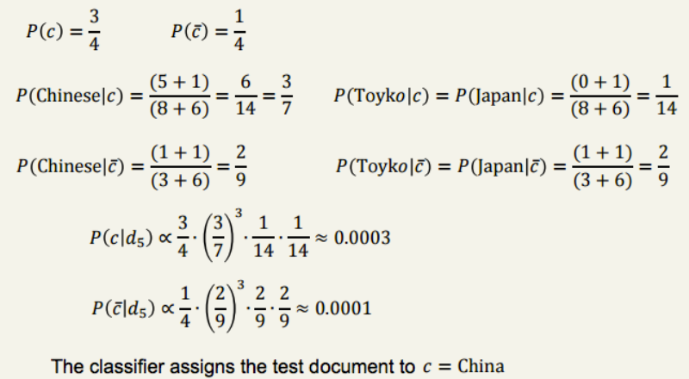
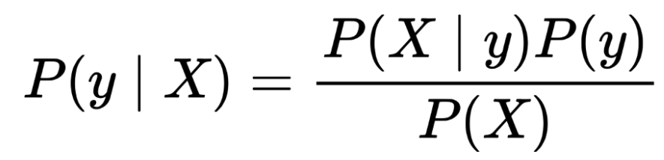
3.5.1 Naive Bayes Classifier

Slide 33
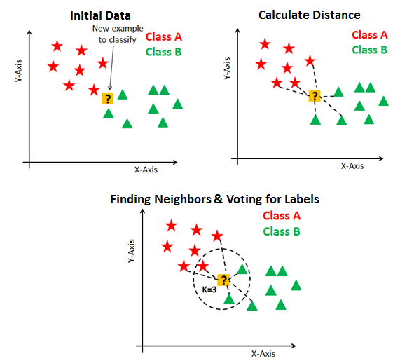
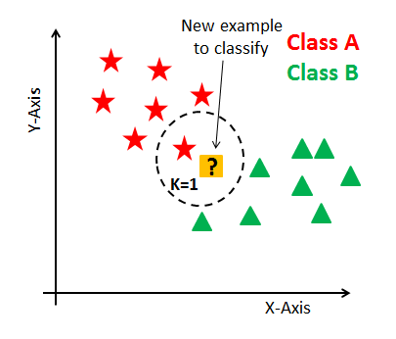
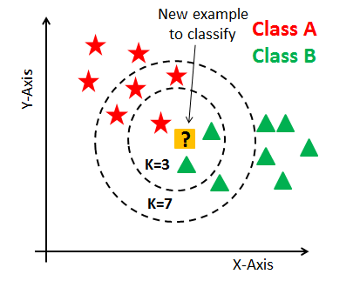
3.5.2 K-nearest Neighbor

Slide 34
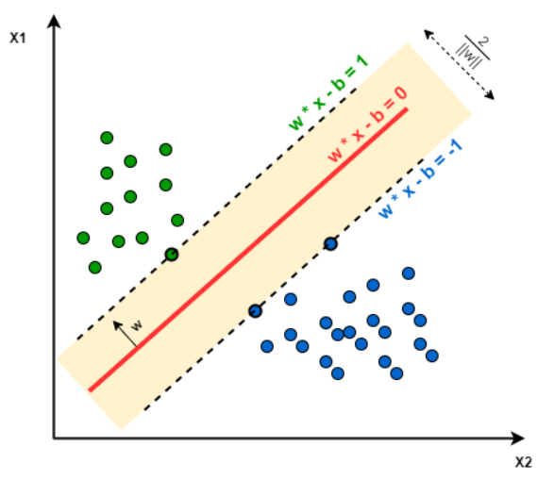
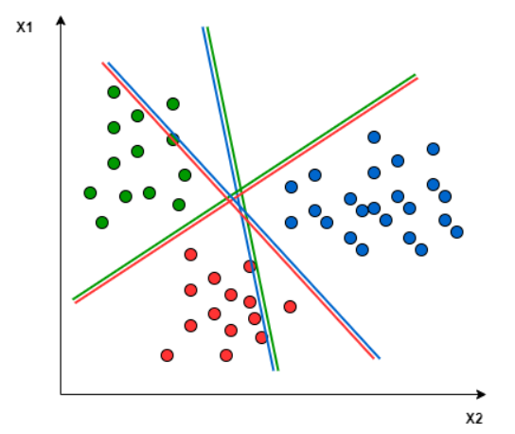
3.5.3 Support Vector Machine
https://en.wikipedia.org/wiki/Support_vector_machine

Slide 35
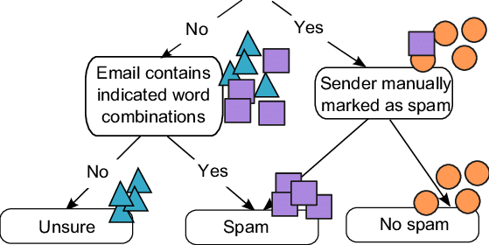
3.5.4 Decision Tree
https://scikit-learn.org/1.5/modules/tree.html

Slide 36
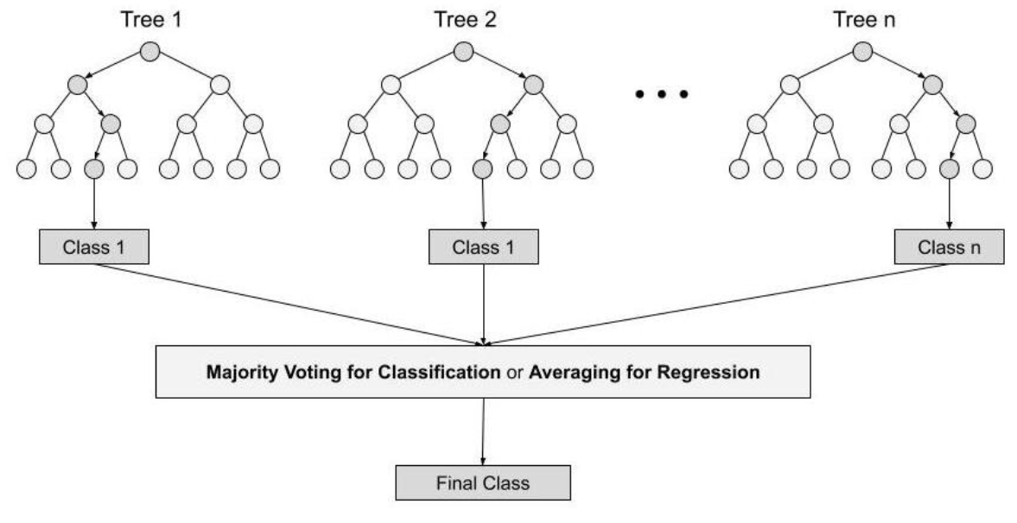
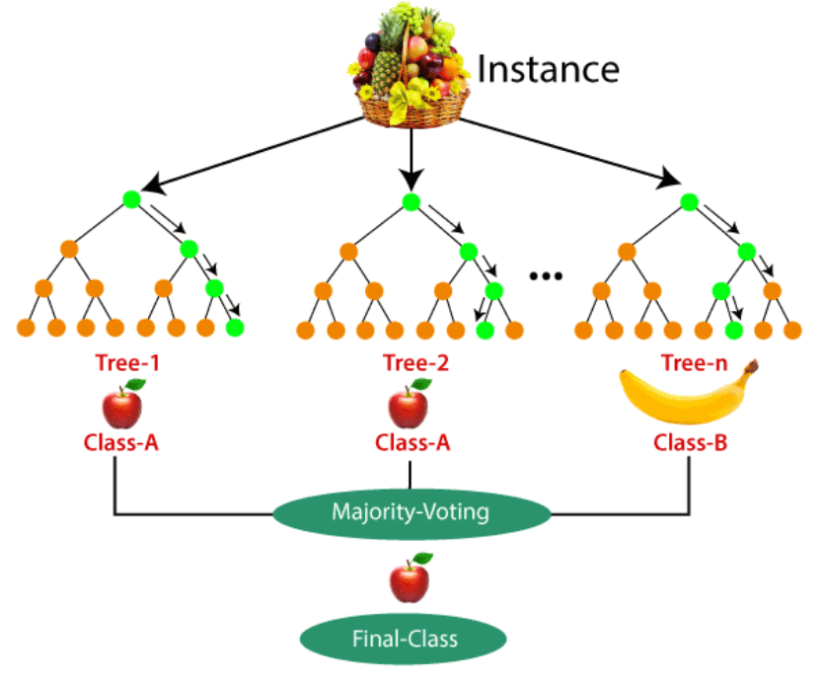
3.5.5 Random Forest
Step 1: In Random forest n number of random records are taken from the data set having k number of records.
Step 2: Individual decision trees are constructed for each sample.
Step 3: Each decision tree will generate an output.
Step 4: Final output is considered based on Majority Voting or Averaging for Classification and regression respectively.

Slide 37
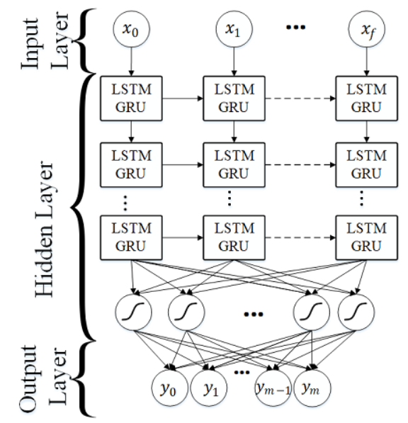
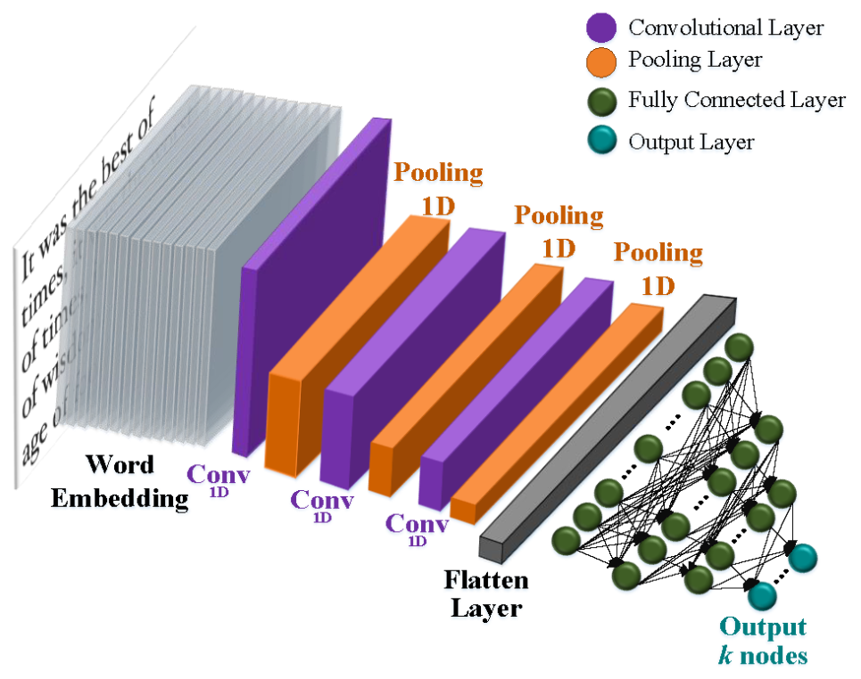
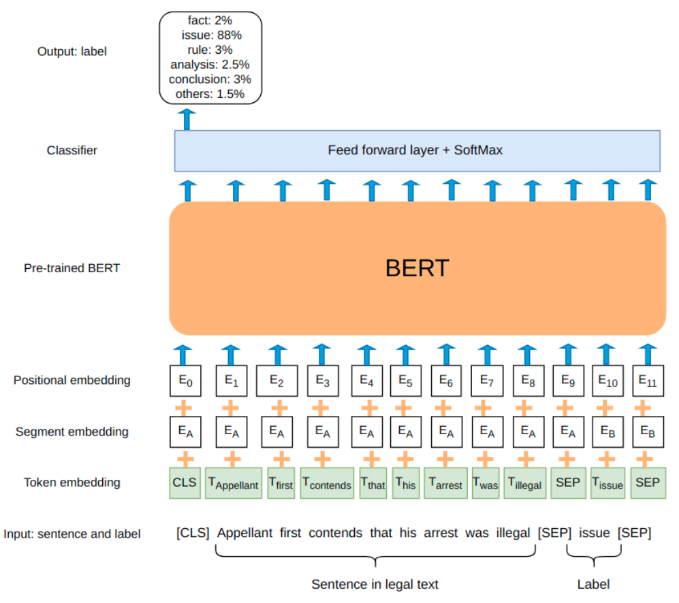
3.5.6 Deep Learning
RNN
CNN
BERT

Slide 38
3.5.7 Semi-supervised learning
Pseudo-labeling: in pseudo labeling, a classifier is trained on both labeled data and the most confident predictions of the previous classifiers on unlabeled data.
Co-training: Co-training is an extension of self-training to multiple classifiers that are iteratively retrained on each other’s most confident predictions.
Transfer Learning: Transfer learning (TL) has been widely used for improving the performance of machine learning across many tasks, and transfer learning by fine-tuning pre-trained neural networks outperforms the networks that are trained from scratch on the same data
Active Learning: Active Learning aims to find the most efficient way to query for labels and learn a classifier with the minimal amount of human supervision. It interactively assigns certain specific data points to users for annotation by identifying the best data to annotate next.
Expectation-maximization: EM is a class of iterative algorithms for maximum likelihood or maximum a posteriori estimation in problems with incomplete data.
GAN: where a “generator” is trained to produce samples resembling some data distribution. The training process “adversarial” depends on a “discriminator”, which is instead trained to distinguish samples of the generator from the real instances.
Notes:
Expectation-maximization: EM is a class of iterative algorithms for maximum likelihood or maximum a posteriori estimation in problems with incomplete data. Usually, the unlabeled data are considered incomplete because they come without class labels. The algorithm first trains a classifier with only the available labeled documents and uses the classifier to assign probabilistically-weighted class labels to each unlabeled document by calculating the expectation of the missing class labels. It then trains a new classifier using all the documents—both the originally labeled and the formerly unlabeled—and iterates.
GAN: where a “generator” is trained to produce samples resembling some data distribution. The training process “adversarial” depends on a “discriminator”, which is instead trained to distinguish samples of the generator from the real instances. Semi-Supervised GAN uses labeled data to train the discriminator, while the unlabeled examples as well as the ones automatically generated improve its inner representations.

Slide 39
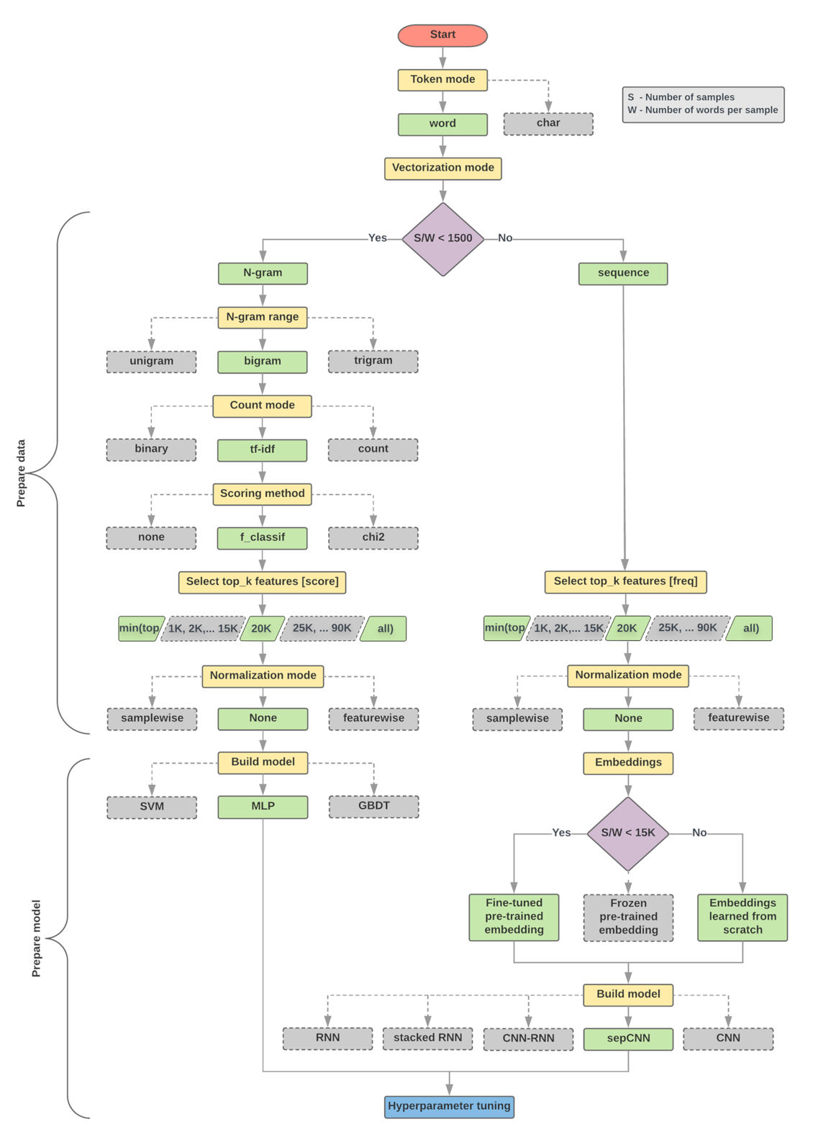
3.6. Factors behind the choice of an ML algorithm?

Slide 40
3.7. Text classification evaluation?
N-fold cross-validation: Split dataset into N folds. Runs test N times. At a time, use one-fold of data as test set, remaining N - 1 folds of data as training sets. Classification accuracy is average of results in N runs.
Hold-out test: Divide dataset into training and test subsets. Varied splits will result in varied results and accuracy, especially for small datasets. Paired t-test can be used to measure significance in accuracy differences.
Evaluation metrics: Accuracy, recall, precision, F-score

Slide 41
3.8. Text classification challenges?
Data
Zero-shot/Few-shot learning. The current model of deep learning is too dependent on numerous labeled data. The performance of these models is significantly affected in zero-shot or few-shot learning.
The external knowledge. As we all know, the more beneficial information is input into a DNN, its better performance. Therefore, we believe that adding external knowledge (knowledge base or knowledge graph) is an efficient way to promote the model’s performance. Nevertheless, how and what to add is still a challenge.
The multi-label text classification task.
Special domain with many terminologies.
Models
How to tradeoff between data and compute resources and prediction performance is worth studying
Performance
The semantic robustness of the model.
The interpretability of the model.
Notes:
(1) Data
For a text classification task, data is essential to model performance, whether it is shallow learning or deep learning method. The text data mainly studied includes multi-chapter, short text, cross-language, multi-label, less sample text. For the characteristics of these data, the existing technical challenges are as follows:
Zero-shot/Few-shot learning. The current model of deep learning is too dependent on numerous labeled data. The performance of these models is significantly affected in zero-shot or few-shot learning.
The external knowledge. As we all know, the more beneficial information is input into a DNN, its better performance. Therefore, we believe that adding external knowledge (knowledge base or knowledge graph) is an efficient way to promote the model’s performance. Nevertheless, how and what to add is still a challenge.
The multi-label text classification task. Multi-label text classification requires full consideration of the semantic relationship among labels, and the embedding and encoding of the model is a process of lossy compression. Therefore, how to reduce the loss of hierarchical semantics and retain rich and complex document semantic information during training is still a problem to be solved.
Special domain with many terminologies. Texts in a particular field, such as financial and medical texts, contain many specific words or domain experts intelligible slang, abbreviations, etc., which make the existing pre-trained word vectors challenging to work on.
(2) Model
Most existing structures of shallow and deep learning models are tried for text classification, including integration methods. BERT learns a language representation that can be used to fine-tune for many NLP tasks. The primary method is to increase data, improve computation power, and design training procedures for getting better results How to tradeoff between data and compute resources and prediction performance is worth studying.
(3) Performance
The shallow model and the deep model can achieve good performance in most text classification tasks, but the anti-interference ability of their results needs to be improved. How to realize the interpretation of the deep model is also a technical challenge.
The semantic robustness of the model. In recent years, researchers have designed many models to enhance the accuracy of text classification models. However, when there are some adversarial samples in the datasets, the model’s performance decreases significantly. Consequently, how to improve the robustness of models is a current research hotspot and challenge.
The interpretability of the model. DNNs have unique advantages in feature extraction and semantic mining and have achieved excellent text classification tasks. However, deep learning is a black-box model, the training process is challenging to reproduce, and the implicit semantics and output interpretability are poor. It makes the improvement and optimization of the model, losing clear guidelines. Furthermore, we cannot accurately explain why the model improves performance.

Slide 42
4
Python Examples

Slide 43
5.1. Text Clustering
K-means: https://github.com/MarcusChong123/Text-Clustering-with-Python
DBSCAN: https://github.com/arnab64/textclusteringDBSCAN
Gaussian Mixture Models: https://colab.research.google.com/github/jakevdp/PythonDataScienceHandbook/blob/master/notebooks/05.12-Gaussian-Mixtures.ipynb#scrollTo=6Lj0uoesKOQw
Hierarchical clustering: https://github.com/dipanjanS/text-analytics-with-python/blob/master/New-Second-Edition/Ch07%20-%20Text%20Similarity%20and%20Clustering/Ch07c%20-%20Document%20Clustering.ipynb

Slide 44
5.2. Text classification – Supervised learning
Text Classification Algorithms: A Survey
https://github.com/kk7nc/Text_Classification#conditional-random-field-crf

Slide 45
5.3. Text classification – Semi-supervised learning
Awesome Semi-Supervised Learning: https://github.com/yassouali/awesome-semi-supervised-learning
Pseudo-labeling: https://towardsdatascience.com/pseudo-labeling-to-deal-with-small-datasets-what-why-how-fd6f903213af
Co-training: https://github.com/revorg7/co-training
Expectation-maximization(EM) + Naive Bayes(NB): https://github.com/jerry-shijieli/Text_Classification_Using_EM_And_Semisupervied_Learning
Pseudo-labeling + DNN: https://github.com/nanazhu/Pseudo-Label-for-Deep-Neural-Networks
GAN-BERT: https://github.com/crux82/ganbert

Slide 46
5.4. Text classification – Reinforcement learning
Reinforcement Learning Toturial: https://techvidvan.com/tutorials/reinforcement-learning/
Reinforcement Learning: An Introduction: https://github.com/ShangtongZhang/reinforcement-learning-an-introduction
Reinforcement Learning algorithms code: https://github.com/dennybritz/reinforcement-learning
Reinforcement Learning course: https://www.davidsilver.uk/teaching/

Slide 47
Thank you

